Slide 1
Windows 101
CIS 5930/4930, Offensive Security
Spring 2013

Slide 2
Lecture Outline
Memory handling
The registry
Windows boot
Windows architecture
systems and subsystem details
PE files
exe and dll
Windows security
Windows domain
Rootkits
Today's talk is
mostly going to
be Win7-centric

Slide 3
Revisiting the disclosure debate
http://www.wired.com/threatlevel/2012/11/att-hacker-found-guilty/
“iPad 3G Account Slurper” Script story breakdown:
Couple of "vulnerability researchers"/hacktivists discover massive problem with AT&T's website:
allows them to access anyone's personal data that owns an iPad
convicted under the Computer Fraud and Abuse Act
widely controversial law, does not define "authorization"
They did a lot of shady things
discussing crashing stocks and short selling them for profit after disclosure (IRC logs)
AT&T/Apple claimed they never were directly approached by the pair, and found out through the press releases
the suspects could not prove otherwise, and have both been found guilty for now

Slide 4
Corrections/Comments from last time
#1: HW 1 is due Jan 24, not 25th which is a Friday
My mistake!
Due in class (please type and not handwrite)
Renderman's Hackers + Airplanes talk at DEFCON
Caused a lot of good
Lots of industry professionals reacted and are trying to fix it, to make us all safer :D

Slide 5
Books used to build this lecture
Windows Internals 6 (part 1 and 2)
The Rootkit ARSENAL: Escape and Evasion in the Dark Corners of the System (2nd edition)
Designing BSD Rootkits
Practical Malware Analysis: The Hands-On Guide to Dissecting Malicious Software
Gray Hat Python: Python Programming for Hackers and Reverse Engineers

Slide 6
First, next week is RE week
What you need to do to prepare (it is super hands on):
Find a laptop (borrow one if you can)
Download (from MSDNAA (see systems group ASAP)) a 32 bit version of Windows
any windows (XP/VISTA/7)
Install the windows 32 bit iso on a virtual machine
5-8GB for the hard drive should be fine
Install CFF Explorer and IDA pro (free trial)
http://www.ntcore.com/exsuite.php
http://www.hex-rays.com/products/ida/support/download_demo.shtml

Slide 7
Segmentation & Paging in Windows
Boundary between the OS and user applications relies heavily on hardware-based mechanisms
Intel 32 based processors (and variants) implements memory protection through both segmentation and paging

Slide 8
Paging
Paging: memory is divided into small partitions (all the same size), and are referred to as page frames. When a process is loaded, it gets divided into pages --- these pages are loaded into the frames
Transparent to programmer (system allocates memory)
No separate protection
No separate compiling
No shared code

Slide 9
Segmentation
Segmentation: memory is allocated in various sizes (segments), depending on the need for address space of a process. Segments can be individually protected, or shared between processes. Segmentation Faults occur when data that is about to be read or written is outside of the permitted address space for that process.
Involves programmer (allocates memory to specific function inside code)
Separate compiling
Separate protection
Share code

Slide 10
Windows NT family
Windows 2000
Windows XP
Windows Server 2003
Windows Vista
Windows Home Server
Windows Server 2008
Windows 7
Windows 8
Windows Phone 8
Windows Server 2012
Then there are 32 bit vs 64 bit, home/professional/enterprise/etc flavors...
*all use:
ntdll.dll
win32api
Windows (NT) Domains
Workgroups
Active Directory
lots of minor system filename changes between 32bit and 64 bit

Slide 11
Windows
Multi-tiered design
Mostly implemented in C / C++ / asm
Can isolate chipset dependencies by using Hardware Abstraction Layers (HAL)
Designed to support many architectures
MIPS
Intel
IBM
etc..
Means lots of places to hide :)
LOTS OF BACKWARDS COMPATIBILITY

Slide 12
Backwards Compatibility
Look we still make all the old stuff work
to keep our customers happy!
Also lets not bother keeping the old stuff up to date!
IS THE BANE OF SECURITY
It's really quite a horrible problem

Slide 13
Examples of Backwards compatibility issues
The following things at some point were a security issue across versions...
LANMAN password hashes
hilariously easy to crack
Metafile Image Code Execution (MICE)
PE file format (still around)
MS XML Core Services (CVE-2012-1889)
IE & Javascript
SNMP
Server Message Block protocol
etc..

Slide 14
Main reasons for windows having so many security "problems"
It is the big dog, marketshare wise
The massive size of Windows code
Hundreds of drivers (most are 3rd party!)
It has a lot of backwards compatibility, user friendliness, autorun, and "plug and play" features that make it target rich
Historically, it has a lot of MS products that are tied into kernel functions (outlook, IE, word, etc) to make them load faster than the competition
But... Its still damn secure! (in my opinion)

Slide 15
Other opinion from critic
"Most of these problems come down to Windows has IPCs (interprocess communications), procedures that move information from one program to another, that were never designed with security in mind. Windows and Windows applications rely on these procedures to get work done. Over the years they've included DLLs (dynamic link libraries), OCXs (Object Linking and Embedding (OLE) Control Extension), and ActiveX. No matter what they're called, they do the same kind of work and they do it without any regard to security." - Steven J. Vaughan-Nichols
So:
Source: http://www.itworld.com/security/75601/why-windows-security-awful

Slide 16
The Windows Overview

Slide 17
The registry
Basically a database for info and config for everything.
regedit.exe
The 5 hives:
HKEY_CLASSES_ROOT
HKEY_CURRENT_USER
HKEY_LOCAL_MACHINE
HKEY_USERS
HKEY_CURRENT_CONFIG

Slide 18
The registry
Works with:
Access Control
Group Policy
Local Security Settings
Permissions
and User Rights Assignment
To define everything the computer and the user can and cannot do

Slide 19
The registry
There are 5 main root keys in the hive categories
visible by default
Are associative arrays and abstract data types that can hold collections of objects
They contain subkeys, which contain values (variables)

Slide 20
The hives
HKEY_CLASSES_ROOT
Contains file type associations
HKEY_CURRENT_USER
Contains preferences and settings of the currently logged on user
supporting files: Ntuser.dat, Ntuser.dat.log

Slide 21
The hives
HKEY_LOCAL_MACHINE
PnP and HAL info is gathered here about the system's hardware
contains software, hardware, and security info
Also pulls info from the 4 other hives:
System
Software
Security
SAM
is one of the most major hive structures

Slide 22
The hives
HKEY_LOCAL_MACHINE (HKLM)
supporting files:
HKLM \SAM: Sam, Sam.log, Sam.sav
HKLM \Security: Security, Security.log, Security.sav
HKLM \Software: Software, Software.log, Software.sav
HKLM \System: System, System.alt, System.log, System.sav
all are stored in %System Root%\System32\config
stores all registry files
usually is C:\Windows\System32\config

Slide 23
The hives
HKEY_USERS
Contains data from every user in the SAM
contains info for that user's:
desktop
environment
program settings
network connections
printers
HKEY_CURRENT_CONFIG
contains PnP data about system's hardware devices that are used in the loading/startup process

Slide 24
Registry notes
Each time a user logs on, a new hive ("user profile hive") is dynamically built for that user
located under HKEY_USERS
Is dynamically created each time the system is booted

Slide 25
The Windows Boot
Post
CMOS
MBR - points to bootmgr - the windows boot manager
Bootmgr - loads and reads the Boot Configuration Data (BCD) file/store
BCD Store - reads which OSes are specified in the BCD store, and displays a menu to select which one

Slide 26
The Windows Boot
bootmgr resumes - loads Winload.exe, the windows boot loader
Winload.exe -
loads the kernel (ntoskrnl.exe), and loads HAL.dll into memory.
Then loads the SYSTEM registry hive
These processes are used to create registry key HKEY_LOCAL_MACHINE\SYSTEM
Winload uses the HKLM\SYSTEM key to load device drivers into memory (without starting them)

Slide 27
The Windows Boot
Winload checks if user wants to start using Last Known Good Configuration (pressing F8 key)
Winload starts:
memory paging (pagefile.sys) and
startup control passes to the ntoskrnl.exe (the windows kernel)
ntoskrnl.exe - causes the HAL to become active
builds HKEY_LOCAL_MACHINE\HARDWARE from info collected thusfar
ntoskrnl.exe starts critical services and drivers
located in C:\Windows\System32\Drivers

Slide 28
The Windows Boot
ntoskrnl.exe starts smss.exe (Session Manager SubSystem)
responsible for handing sessions running on a machine
starts the kernel and user modes of the Win32 subsystem
win32k.sys (kernel mode)
winsrv.dll and csrss.exe (both user mode)
starts any subsystems listed with the "Required" value in the following registry key:
HKLM\System\CurrentControlSet\Control\Session Manager\Subsystems
creates environment variables, virtual memory paging files
smss.exe = historically common target for malware
first native application in boot/startup

Slide 29
The Windows Boot
smss.exe starts the Win32 graphics subsystem
smss.exe starts csrss.exe (Client Server Runtime SubSystem)
provides the user mode side of the Win32 subsystem
console handling and GUI shutdown
the second native application
smss.exe starts Winlogon.exe (the logon manager)
Winlogon.exe starts services.exe (Service Control Manager)

Slide 30
The Windows Boot
Winlogon.exe starts lsass.exe (Local Security Authority Process)
displays the logon screen, prompting for user id and password.
handles authentication
Winlogon.exe executes userinit.exe
Userinit.exe
applies Group Policy settings and startup and policy settings
in the local user registry
not overridden by the Active Directory Group Policy

Slide 31
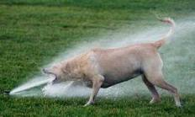
The Windows Boot
Winlogon launches Explorer.exe, the windows graphical Window Manager and shell
Whew thats a lot
that happens!

Slide 32
Subsystem Startup
Subsystems are started by the Session Manager (Smss.exe) process
Smss information is stored at:
HKLM\SYSTEM\CurrentControlSet\Control\Session Manager\Subsystems
starts any subsystems listed with the "Required" value in the following registry key

Slide 33
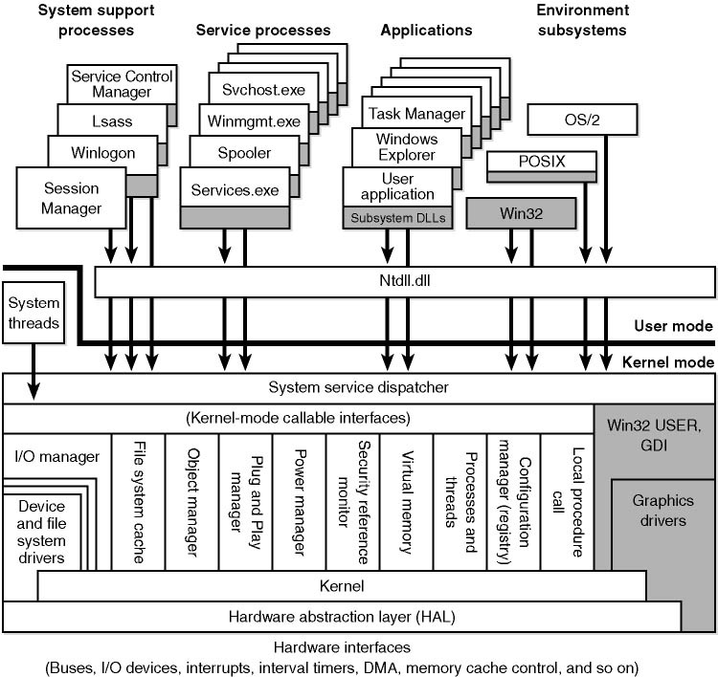
WINDOWS XP / WINDOWS 2000

Slide 34
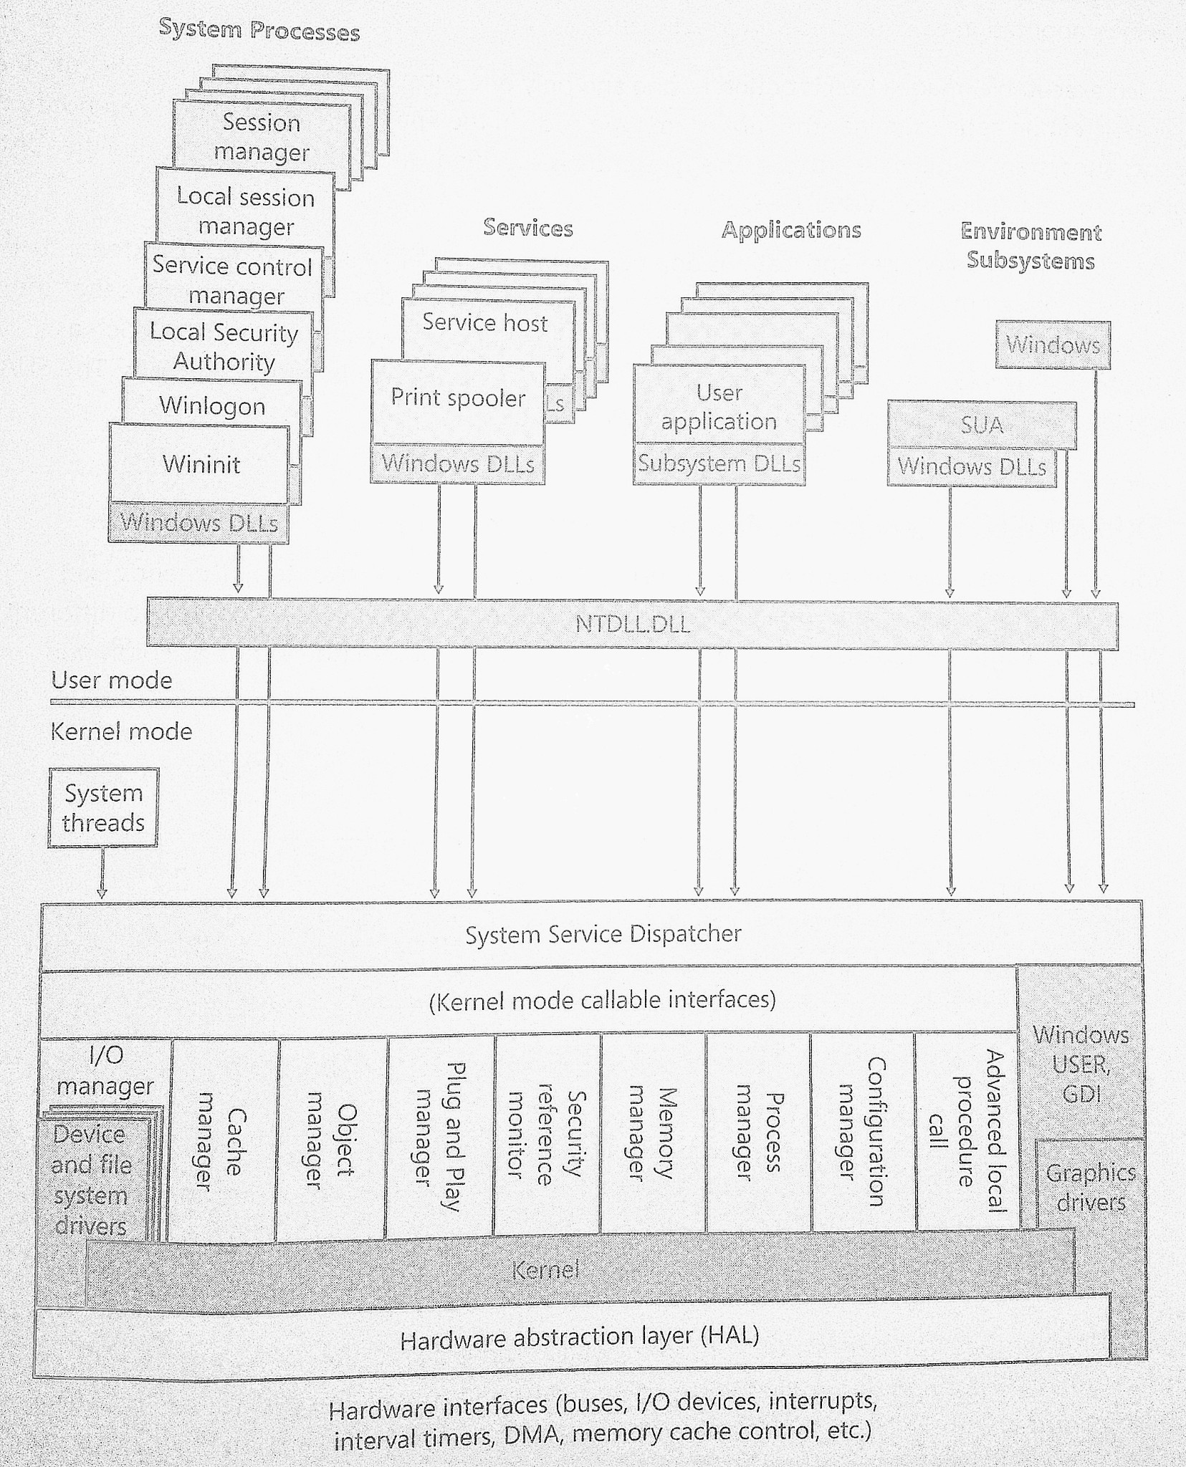
SUA = Subsystem for Unix-based
Applications
WINDOWS 7 / WINDOWS VISTA
Source: Windows Internals 6th edition, Part 1

Slide 35
Win32 API & native API
Windows has a layered architecture
in order to program applications on it's OS, Windows provides the Win32 API:
These are the subsystem DLL's
Are well documented, and call the native API
In order to communicate with the kernel, windows provides a native API (located usually in ntdll.dll)
ntdll.dll functions have no documentation
Window's famous hidden API

Slide 36
SUA = Subsystem for Unix-based
Applications
WINDOWS 7 / WINDOWS VISTA
Source: Windows Internals 6th edition, Part 1
Win32 API
(undocumented)

Slide 37
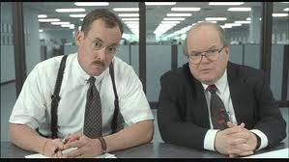
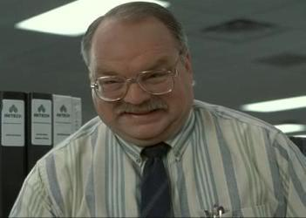
Win32 API & native API
The role of the subsystem DLL's is to translate a documented function into the appropriate internal (and mostly undocumented) native system calls (for security in depth)
Basically the subsystem DLL's

Slide 38
Win32 API breakdown
Functions fall in 8 categories:
Base Services
file system, devices, processes, threads, err handling
Advanced Services
registry, shutdown, service management, user account management (advapi32.dll)
Graphics Device Interface
monitor output, printers, and etc
User Interface
windows, buttons, menus, scrollbars, etc...
Source:
http://en.wikipedia.org/wiki/Windows_API

Slide 39
Win32 API breakdown
5. Common Control Library
- status bars, progress bars, toolbars, tabs..
6. Common Dialog box library
- dialog boxes and fonts...
7. Windows Shell
- os system shell (shell32.dll, shlwapi.dll)
8. Network Services
-networking, NetBIOS, Winsock, NetDDE, RPC (netapi32.dll)
Source:
http://en.wikipedia.org/wiki/Windows_API

Slide 40
Win32 API files
Kernel32.dll
exports most of the wind32 base APIs, such as memory management, I/O, process and thread creation, & synchronization functions
GDI32.dll
exports Graphics Device Interface functions
User32.dll
exports functions that create/manipulate the Windows Users Interface
Comctl32.dll
File open / save / save as / progress pars, etc...

Slide 41
ntdll.dll
mostly undocumented (by Microsoft)
historically "well" documented on the underground
majority of applications do not call ntdll.dll
Applications that link/call ntdll.dll directly are called native applications
cannot be run by a User
vast majority of exported functions (aka symbols) are prefixed with "NT"
NtDisplayString, NtReadFile, NtWriteFile
ReadFile calls NtReadFile
WriteFile calls NtWriteFile

Slide 42
Exported Functions
How API's are provided...
EXEs and DLLs export functions to interact with other programs and code
most common in DLLs, rare in EXEs
malware that exports functions will use intentionally misleading function names

Slide 43
PE files / Importing functions
Portable Executable
.cpl, .exe, .dll, .ocx, .sys, .scr, .drv
Contains info as to what functions are imported / exported in its headers (call tables)
When reverse engineering PE's, looking at the imported functions is informative
Can play tricks and import functions by indirect reference
common in malware
i.e. import the 6th function in winsrv.dll

Slide 44
PE files / Importing functions
When applications are compiled,
API calls do not use hardcoded addresses
Work through a function pointer
Organized in a table
The Import Address Table (IAT)
This way each API call doesn't have to be touched up by the compiler with the correct jump address for the API code
packed executables mess with the process IAT table to make it smaller (we'll cover executable packing later :)

Slide 45
Interesting functions malware may often use
From Kernel32.dll
CreateFileW | opening and manipulating files
FindFirstFileW | for traversing directories
FindNextFileW | for traversing directories
GetCurrentProcess | for open and manipulating processes
GetProcessHeap | for open and manipulating processes
OpenProcess | for open and manipulating processes
ReadFile | opening and manipulating files
WriteFile | opening and manipulating files

Slide 46
Interesting functions malware may often use
from User32.dll (user environment / GUI)
RegisterClassExW | Gui Creation/Manipulation (does not have to appear for user)
RegisterHotKey | Whenever a hotkey is pressed (even in the focus of other applications), this application will be notified (i.e. CTRL-SHIFT-P)
SetWindowTextW | Gui Creation/Manipulation (does not have to appear for user)
SetWindowsHookExW | Commonly used by malware to hook things (i.e. for keylogging)
ShowWindow | Gui Creation/Manipulation (does not have to appear for user)

Slide 47
Interesting functions malware may often use
from Advapi32.dll (for manipulating the registry)
RegCloseKey | for viewing / changing the registry
RegDeleteValueW | for viewing / changing the registry
RegOpenCurrentUser | for viewing / changing the registry
RegOpenKeyExW | for viewing / changing the registry
RegQueryValueExW | for viewing / changing the registry
RegSetValueExW | for viewing / changing the registry

Slide 48
Interesting functions malware may often use
Shell32.dll (for launching other applications)
CommandLineToArgvW | Parses a Unicode command line string and returns an array of pointers to the command line arguments, along with a count of such arguments, in a way that is similar to the standard C run-time argv and argc values.
SHChangeNotify | Notifies the system of an event that an application has performed. An application should use this function if it performs an action that may affect the Shell.
ShellExecuteExW | Performs an operation on a specified file.
ShellExecuteW | Performs an operation on a specified file.

Slide 49
Security in Win 7
Data Execution Prevention (DEP)
Address Space Layout Randomization (ASLR)
/GS Compiler option and /SAFESEH linker option
Kernel Patch Protection
Enhanced mitigation Experience Toolkit (EMET)
User Account Control (UAC)
These are the consent command prompts
All users (including administrators) run as Standard user by default (can still download malware)
Prompt for administrator access
From Vista: vast reduction in number of OS applications that require elevated privileges
We will cover later on

Slide 50

Security in Win 7
SAM ([local] Security Accounts Manager)
stores the users' passwords in a hashed format
in %System Root%\System32\config\
LM hash and NTLM hash
Windows kernel has exclusive filesystem lock on the SAM file to prevent any sort of online copying
can only be copied/opened by users while system is offline
SYSKEY function introduced to improve the security of the hash
on disk copy of SAM file is partially encrypted with a key (the SYSKEY)
in memory version of SAM can still be dumped while online
via pwdump and similar tools
Note: In windows 2000 and before, if an attacker deleted the SAM file, no passwords were required

Slide 51
Security in Win 7
Better Desktop Auditing (Event Viewer)
XML based logs
tasks tied to events
fine grained support for audit of administrator privilege
easier to filter "noise" out to find the vents you want
reworked event viewer
also I suggest checking out Splunk!
Network Access Protection
Helps insure that machines that connect to corporate networks meet corporate policy, are fully patched, and have up to date AV

Slide 52
Security in Win 7
Direct Access
When enabled, IT departments are allowed full access (via an IPSEC tunnel) to a machine.
Happens without knowledge of a user (a "seemless" experience) --- makes IT high value target
App Locker
Helps IT eliminate unknown and unverified applications in the network
black lists, white lists, publisher rules based off of digital signatures

Slide 53
Security in Win 7
RMS (Rights Management Service)
Fine grained access control for documents
can control whether users can copy, print, etc a document
Bit Locker
full HD encryption (desktops, laptops, and even thumbdrives)
focused on protecting the OS volume / partition
best used on dual / multi partition setups

Slide 54
Least Privilege in Win 7
All registry keys implement access control through:
Access Control Entries (ACE) in Discretionary Access Control Lists (DACLs)
ACE controls or monitors access to an object by a specified trustee
ACE entries contain:
SID (security identifier for the trustee)
access mask (specifies the access rights)
a flag that indicates the type of ACE (6 types)
a set of flags to dictate if ACE applies to child containers/directories

Slide 55
Least Privilege in Win 7
DACL
controlled by the owner of an object
a NULL DACL permits all types of access to all users (do not use NULL DACLs)
is an important part of application development

Slide 56
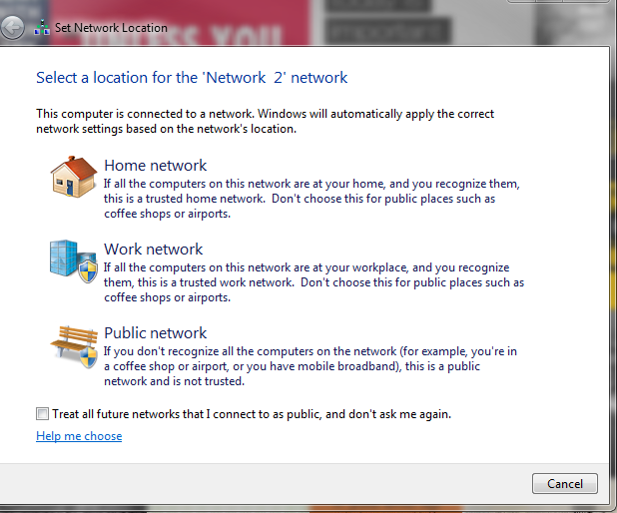
Domains, Workgroups, and Homegroups
All computers running Windows on a network MUST be part of a workgroup or domain
Windows PC's running on "home networks" can be also part of a homegroup, but not required

Slide 57
Workgroup
All PCs are peers
No PCs has control of another PCs
each PC has a set of user accounts
to log on a PC in the workgroup, you must have an account on that PC
There is usually a 20 PC cap
A workgroup is not protected by a password
all PCs must be on the same LAN or subnet

Slide 58
Homegroup
PCs in a homegroup must belong to a workgroup as well.
Homegroup makes it easy to share pictures, music, videos, documents, and printers
Homegroup IS password protected
password is only typed in once, when adding the pc to the homegroup

Slide 59
Domain
One or more PCs are servers
Network admins use servers to control the security and permissions for all PCs in the domain.
any changes are automatically made to all PCs in the domain
Password/Credentials required each logon
If user has a domain account, he/she can log onto any PC on the domain
without needing a local account on that PC
Thousands of PCs on a domain
Can span across networks

Slide 60
Windows Domain
History:
Microsoft wanted a way to just make everything work seamlessly together.
Plug it into the network and you can start sharing, collaborating, etc.
Started with LANMAN (LAN Manager), and then NTLM (NT LANMAN) protocols.
LANMAN hashes were easy to break
NTLM replaced it, but lots of things were backwards compatible with LANMAN until NTLM v2 came along

Slide 61
Windows Domain
Collection of security principals that share some centralized directory database on a network.
Database history:
Active Directory (win2000) Active Directory Domain Services (win serv2008)
servers that run Active Directory are called "domain controllers"
Uses LDAP v2/v3, Kerberos, and DNS
NT Directory Services or NTDS on Windows NT systems prior to Active Directory

Slide 62
Windows Domain
Each person who uses computers with on a domain received their own unique user name.
this account can be assigned access to resources in the domain
Domain connections supported over LAN, WAN, or VPN
VPN makes it a pivoting target

Slide 63
Windows Domain Protocol
Security/Protocol history:
LANMAN
LM hashes were notoriously weak
still appears some places for backwards compatibility (even in apple OSes!)
NTLMv1 (NT LANMAN)
provided backwards compatibility w/ LANMAN
NTLMv2 introduced Windows NT 4.0
used HMAC-MD5 for authentication
uses CRC & Message Digest algorithms for integrity
Uses RC4 for encryption (no support for AES/SHA2)
Kerberos adopted since Windows 2000
100% BROKEN (at some point)
NTLM 2 sessions are similar to MS-CHAPv2 (recently broken!)

Slide 64
Windows Domain Protocol
Kerberos has replaced NTLM as the default authentication protocol in Active Directory, but
NTLM widely/default used where the client:
cannot access Domain controller
is authenticating to a server using an IP addr
is authenticating that belongs to a different Active Directory forest that has legacy NTLM trust...
is authenticating to a server not part of a domain
cannot access kerberos ports due to firewall

Slide 65
Windows Firewall
On by default in win7
Has Home/Work/Public profiles
Ties connections to applications
incoming and outgoing
can require user consent
Application white list
can block all other incoming connections

Slide 66
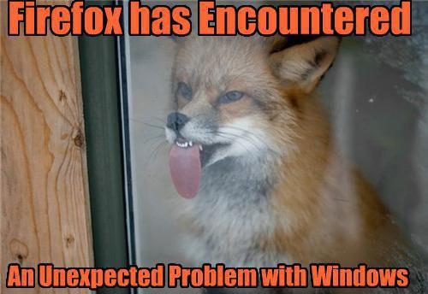
When things go wrong
Program / Browser inexplicably crashes
BSOD
or other crashes
etc
usually the worst
is fixable with
system restore

Slide 67
The Ugly
Rootkits!
The following material comes from: The Rootkit ARSENAL

Slide 68
Rootkits
Who builds them?
Marketing ("what is security???" :D )
Digital Rights Management
"features" / anti-cheating
Law Enforcement
Industrial Espionage
Political Espionage
Cybercrime

Slide 69
Getting into the kernel
Kernel Mode Drivers (KMD), are the official channel to gain access to hardware (ring 0)
for system engineers
can be loaded by user applications
are like training-wheels for rootkit design
KMD's are usually .sys files
C:\Windows\system32\drivers\
offers: high complexity (can do a lot)
cost: low stealth / high detection
not difficult to code
User .EXE
win32 API DLLs
NTDLL.dll
User
Kernel
SYSENTER
KiFastCallEntry()
System Calls (NT*())
I/O Manager (IO*())
I/O Request Packets (IRP)
KMD (.sys)
hal.dll (Hal*() )
Hardware

Slide 70
Windows Kernel Mode Security
"Kernel-Mode Code Signing" (KMCS)
When 64 bit windows came out, Microsoft required KMD's to be digitally signed with a Software Publishing Certificate
Code signing does work!
associates drivers with authors/vendors
not applicable to 32 bit versions
Though, now all versions do require:
signed: a subset (small) of core system binaries
signed: boot drivers
attackers can still piggy back on signed drivers!

Slide 71
KMCS Countermeasures
Not easy, involves piggybacking on "existing" drivers
How attackers change that "existing" problem:
With money and a cover, can buy a SPC
way too brazen
release KMD with backdoor disguised as a bug
has occurred before
Bad guys can get a job at a third party vendor and introduce backdoor/bug
OR instead, KMD Exploits

Slide 72
Getting into the kernel
Kernel / KMD Exploits
Hundreds of drivers, and most are by 3rd parties
Nothing Microsoft can do about it
*Easy* and statistically likely to find bugs / exploits
requires being a master of stack overflows / shellcode / ROP / etc...
"This is the most generic attack today." - Joanna Rutkowska in the Rootkit Arsenal book
The basic exploit payload is also a KMD, but leave zero to little footprints
high stealth
high complexity

Slide 73
Getting into the kernel
Modifying Call Tables / Hooking
A Call table is an array where each element stores the address of a routine/function
IAT for user space
IDT, CPU MSRs, GDT, SSDT, IRP Dispatch Table for kernel space
Hooking = changing legitimate call table addresses with your own addresses
challenging in kernel, multiple copies of the GDT, IDT, and MSRs on a machine
common targets:
processes, drivers, files & directories, Registry keys, and network ports

Slide 74
Getting into the kernel
Basics to an attacker's hook routine:
save existing entry in target call table
swap in new address for attacker hook
restore old entry when done (Why???)
usually left over from rootkit development
Block calls made by certain applications (AV)
Entirely replace the original routine
Monitor system by intercepting input params
Filter output parameters
Perform malicious routine code, then call original routine

Slide 75
Hooking Countermeasures
Hooking *can* be easy to detect
known good address ranges
Can look for *sane* address values in the IDT, CPU MSRs, GDT, SSDT, IRP...
Counter Countermeasure!
The above hooking checks all use the same system call to check the call tables (ZwQuerySystemInformation() )
hook on this to override it
Detour patching: leave call table alone, just add a jump to your hook in the original routine!

Slide 76
Getting into the kernel
Patching Methods
Binary Patching
modify the binary on disk, wait for reboot(bootkit)
easy to detect
Run-time Patching
modify memory image of a module
super hard to detect
Ways to code patches:
In-place patching
if a routine is only 10 bytes long, use only 10 bytes to do malicious hook (quite limited)
Detour patching
prologue & epilogue detours
(High complexity)

Slide 77
Once you get into the kernel
Attackers like to stay there
Its really hard work getting there!
try to find ways to retain access across reboots and even updates
patching kernel
patching some part of the boot process

Slide 78
Kernel Patch Protection (KPP)
MS introduced PatchGuard to guard the kernel against malicious patching.
Periodic checks on core components against known good signatures or copies:
ntoskrnl.exe
hal.dll
ci.dll (windows 7 Code Integrity DLL)
kdcom.dll
pshed.dll
clfd.dll
ndis.sys
tcpip.sys
If the periodic check fails, the system dies
periodic checks can occur every few miliseconds

Slide 79
KPP Countermeasures
Only modify the parts of the kernel long enough to get in and establish a foothold, and then replace what you changed with the original code (must occur kinda quickly)
KMD's and Patchguard operate at ring 0
A custom KMD or KMD Exploit can just disable PatchGuard!
Microsoft combats this with just crazy amounts of obfuscation
Wonderful resource: http://uninformed.org/

Slide 80
Theoretical Countermeasures
Both hooks and detour patches modify constructs that are pretty static
Thus is is possible to safeguard against them by:
explicitly reconstructing them from known good versions
checksum-based signature detection
i.e. check against known good signature for contents of a table or routine
direct binary comparison detection

Slide 81
But we can break this by
Modifying Kernel Objects or, Direct Kernel Object Manipulation (DKOM)
Objects here are abstractions for system resources
do not confuse with object oriented terminology
Objects are C structures
C is not a object oriented language
Changes to Objects are handled by the Object manager subsystem (too many subsystems!!!!)
Common targets:
EPROCESS object (to hide a process)
DRIVER_SELECTION object (load & hide KMB)
Token object (subverts entirety of authentication),

Slide 82

And so on
There are countermeasures to these attacks
And counter countermeasures to their defenses!
and so on
and so on

Slide 83

Questions?
LANMAN
win32
DOMAIN
DKOM
SMSS
NTDLL
Active Directory
Registry
magnets

